Slide 1

INFOM453 : LABORATOIRE EN INFORMATIQUE AMBIANTE ET MOBILE
Présentation du projet
Axel Halin Cyril Carlier Dorian Lecomte

Slide 2
Rappel

Slide 3
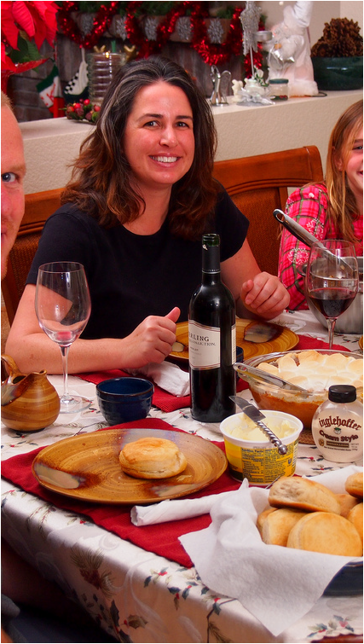
Personna n° 2 : Martine

Slide 4
Aspects clés du projet
Besoin green IT :
Gestion automatisée du chauffage et de l’éclairage
Gestion en fonction d’un agenda Google (pas réalisé par manque de temps)
Besoin sécurité :
Authentification sur l’application smartphone
Détection des incendies
Redondance de l’information obtenue des capteurs
Besoin confort :
Roue a épice
Eclairage et chauffage automatisés

Slide 5
Vidéos

Slide 6
Vue d’ensemble

Slide 7
Check List :
Phidgets :
V Task 1 : Deploy at least one of the Phidget boards connected to the rasberry PI
V Task 2 : Retreive and transmit information from at least two different environmental sensors
V Task 3 : Read and write information from a RFID tag (read in projet, write in video)
SCALA
V Task 1 : Retrieve information read concurrently from multiple sensors connected to the Raspberry
V Task 2 : Infer knowledge involving readings from at least two different sensor types
V Task 3 : Manage gracefully and (reactively) suddent connections and disconnections of a sensor sources
Zolertia Z1
Task 1 : Deploy a basic application on a Zolertia Z1 mote
Task 2 : Retreive data read from one of the Z1’s onboard sensors and send it to a server
V Task 3 : Measure the Z1’s connection strength and behaviour from (challenge)

Slide 8
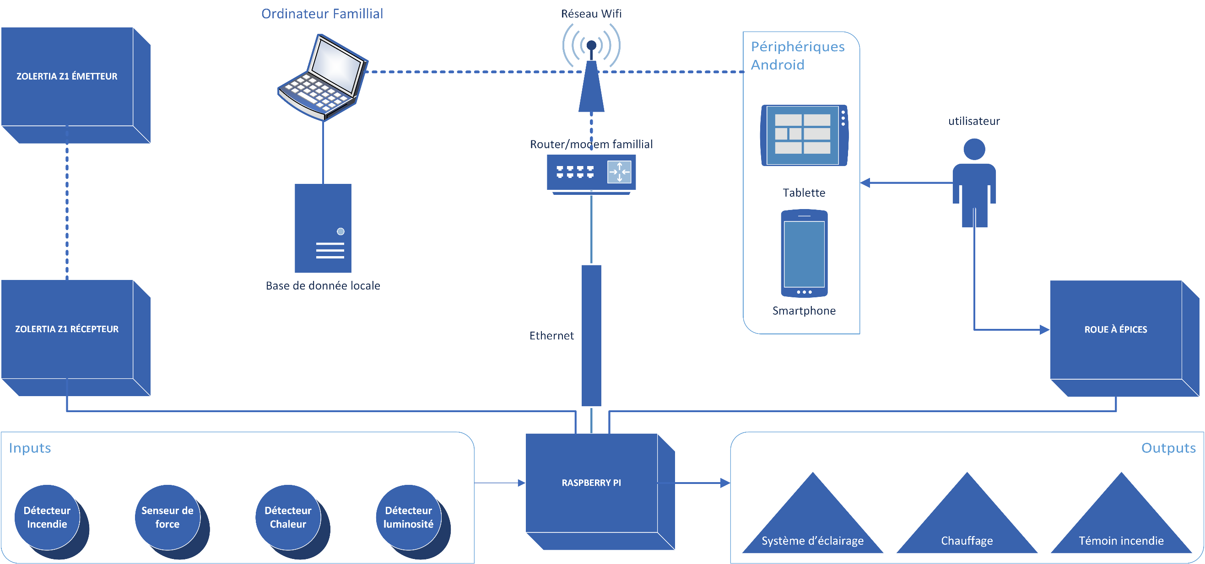
Infrastructure du projet

Slide 9
Aspects techniques
Langages de programmation :
SCALA
JAVA
Base de données
MySQL
Architecture REST
Modularité et indépendance des composants logiciels
Détecteur incendie : tolérance aux pannes + redondance des informations

Slide 10
Smart Home

Slide 11
Démonstration
TO DO

Slide 12
Tâches du projet squelette abordées :
Deploy at least one of the Phidget boards connected to the rasberry PI
Retreive and transmit information from at least two different environmental sensors
Retrieve information read concurrently from multiple sensors connected to the Raspberry PI
Manage gracefully and (reactively) suddent connections and disconnections of a sensor sources

Slide 13
Roue à épices

Slide 14
Démonstration
To Do

Slide 15
Tâches du projet squelette abordées :
Read information from a RFID tag

Slide 16
Merci

Slide 17
Task 3
Read and write information from a RFID tag

Slide 18
SCALA

Slide 19
Task 1
Retrieve information read concurrently from multiple sensors connected to the Raspberry PI or Zolertia Z1 motes

Slide 20
Task 2
Infer knowledge involving readings from at least two different sensor types

Slide 21
Task 3
Manage gracefully and (reactively) suddent connections and disconnections of a sensor sources

Slide 22
Zolertia Z1

Slide 23
Zolertia

Slide 24
Task 1
Deploy a basic application on a Zolertia Z1 mote

Slide 25
Task 2
Retreive data read from one of the Z1’s onboard sensors and send it to a server

Slide 26
Task 3
Measure the Z1’s connection strength and behaviour from
➔ Réalisé pendant le challenge

Slide 27

Et puis…

